Slide 1
CoAP Protocol
Vraj Suratwala
Department of ICT

Slide 2
Introduction
Constrained Application Protocol (CoAP) is a specialized, lightweight web transfer protocol designed by the IETF (RFC 7252 / RFC 7228) specifically for resource-constrained IoT devices and networks. It brings standard RESTful web architecture to low-power, lossy environments.
Core Features & Key Metrics
  ransport: Operates over UDP (Port 5683 for standard, 5684 for DTLS secured) instead of TCP.
  Efficiency: Features a fixed 4-byte header, making header sizes up to 10× smaller than traditional HTTP headers.
  Performance Impact: Demonstrates up to 64x better performance and significantly lower power consumption compared to HTTP:

Slide 3
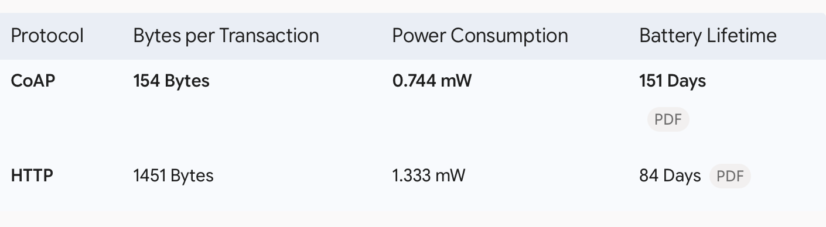
Difference Between COAP & HTTP

Slide 4
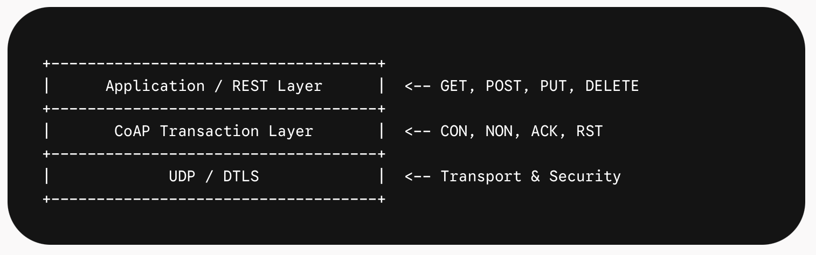
Protocol Architecture & Two-Layer Structure
CoAP abstracts web functionality into two layers running over UDP:
Transaction Layer: Manages single message exchanges, asynchronous messaging, congestion control via retransmissions, and multicasting.
Request/Response Layer: Handles RESTful methods (GET, POST, PUT, DELETE) and response mapping. REST payload data is piggybacked inside transactional messages.

Slide 5
Four Basic Message Types
Because UDP lacks built-in reliability, CoAP introduces four distinct message types at the transaction layer to manage message delivery:
Confirmable (CON): Requires an explicit Acknowledgment (ACK). If no ACK is received within a timeout period (ACK_TIMEOUT), exponential backoff retransmission occurs up to MAX_RETRANSMIT times.
Non-Confirmable (NON): Reliable delivery is not required ("fire-and-forget" or broadcasts).
Acknowledgement (ACK): Confirms receipt of a CON message; can piggyback data responses directly inside.
Reset (RST): Sent when a CON message is received but context or processing capability is missing.

Slide 6
CoAP Key Architectural Actors
Endpoints: Message sources and destinations.
Proxies (Intermediaries): Perform protocol translation (e.g., Cross-proxying between CoAP and standard HTTP/cloud services) or caching to allow sleeping edge nodes to conserve power.
Observers: Clients that register interest in a resource using a modified GET request. The server automatically sends notifications to observers whenever the resource state updates (similar to the MQTT publish/subscribe model)

Slide 7
Message Structure & REST Mapping
URI Scheme: Uses coap://host:port/path?query or coaps:// for DTLS security.
Response Codes: Maps HTTP-style status codes into a compact binary format (e.g., 2.01 Created, 2.04 Changed, 2.05 Content, 4.04 Not Found).
Resource Discovery: Exposes resources natively through a GET request to /.well-known/core

Slide 8
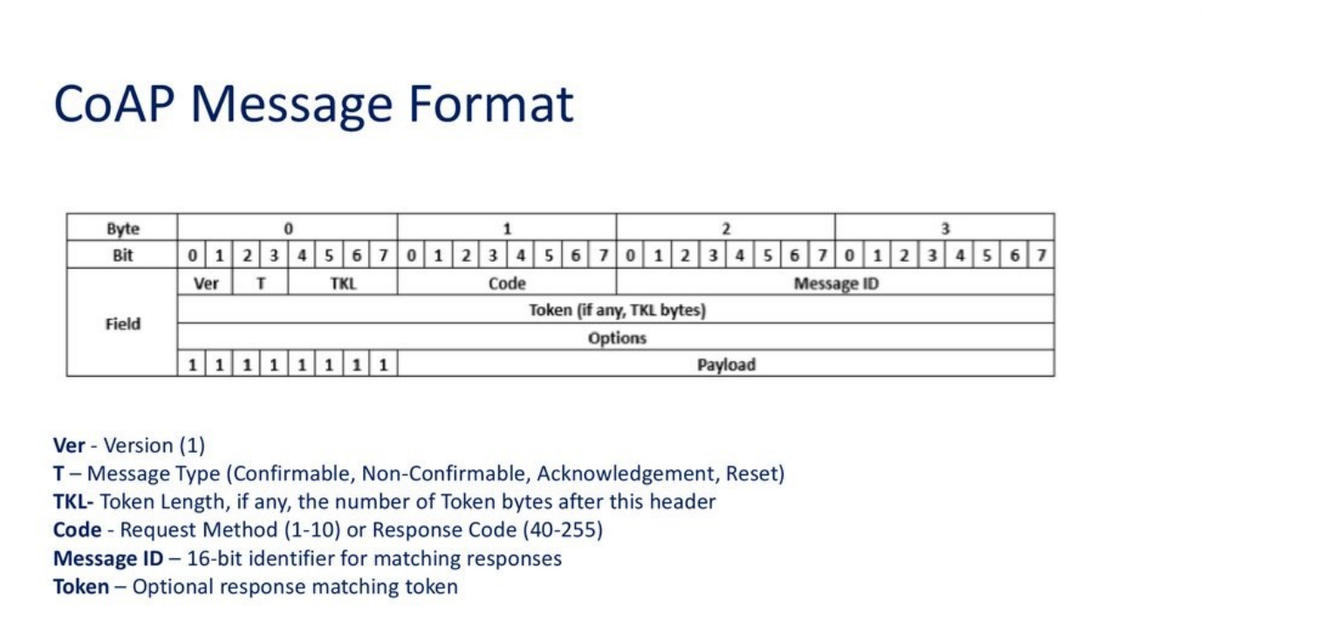

Slide 9
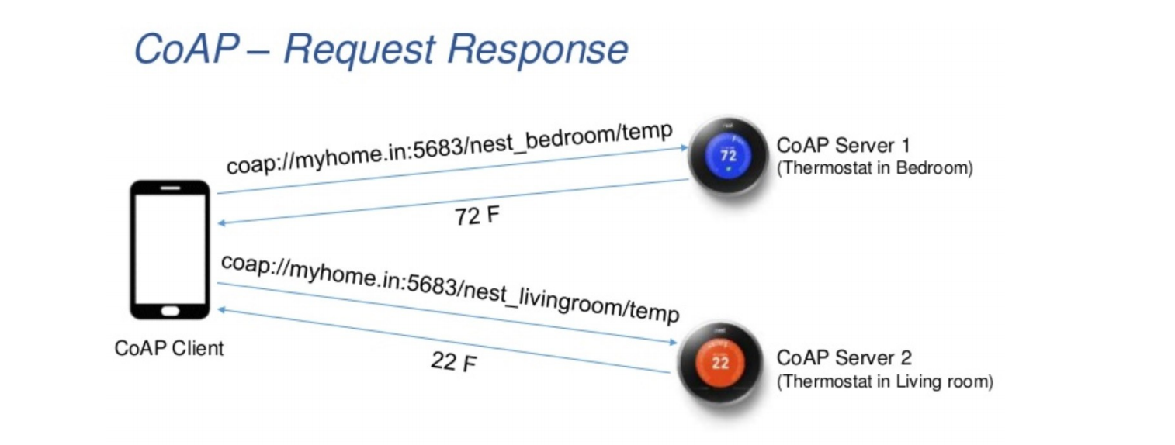
COAP REQUEST-RESPONSE

Slide 10
Thank You
Vraj Suratwala
Department of ICT, VNSGU

